Slide 1
A core Course on Modeling
Introduction to Modeling
0LAB0 0LBB0 0LCB0 0LDB0
c.w.a.m.v.overveld@tue.nl
v.a.j.borghuis@tue.nl
S.6

Slide 2
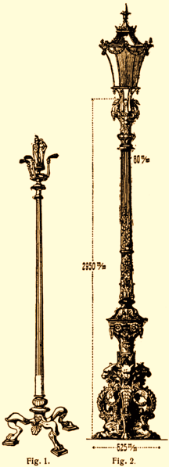
Possible purposes:
abstract
unify
analyse
explore
decide
optimize
verify
communicate
explain
train
predict (1)
predict(2)
compress
control
specify
2
define
formulate
purpose
http://commons.wikimedia.org/wiki/File:L-Kandelaber.png
conceptualize
identify
entities
choose
relations
formalize
obtain
values
formalize
relations
execute
operate
model
obtain
result
conclude
present
result
interpret
result
Notes:
2
The panel suggests purposes, both by exercising with the 3 questions and by mentioning possible goals of the model. Watch the video a second time, and try to find out which questions the kwik kwek and kwek ask, which goals they suggest, and whether or not these are consistent.
After having do that, I ask you to press the pauze-button on this video and try to answer for yourself what, in the case of streetlamps, the purposes from the given list would mean.

Slide 3
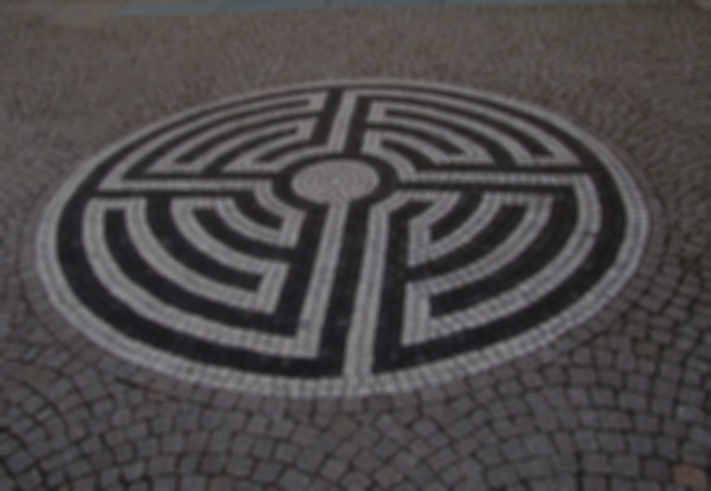
Possible purposes:
abstract
unify
analyse
explore
decide
optimize
verify
communicate
explain
train
predict (1)
predict(2)
compress
control
specify
QUIZ
For each of these purposes, think of a plausible example in the case of street illumination.
3
define
formulate
purpose
http://commons.wikimedia.org/wiki/File:L-Kandelaber.png
conceptualize
identify
entities
choose
relations
formalize
obtain
values
formalize
relations
execute
operate
model
obtain
result
conclude
present
result
interpret
result
Notes:
3
The panel suggests purposes, both by exercising with the 3 questions and by mentioning possible goals of the model. Watch the video a second time, and try to find out which questions that kwik kwek and kwek ask, which goals they suggest, and whether or not these are consistent.
After having do that, I ask you to press the pauze-button on this video and try to answer for yourself what, in the case of streetlamps, the purposes from the given list would mean.

Slide 4
abstract: ‘ignoring the dimensions of the lamp compared to the height, what difference does that make for the light distribution?’
unify: ‘does the light distribution in the street behave in a similar way as, e.g., a temperature distribution in a rod?’
analyse: ‘how do the locations of maximal and minimal light depend on the height and the distance between lamps?’
explore: ‘how can we place street lamps (both sides, zigzag, centre of the street, ...)?’
4
define
formulate
purpose
http://commons.wikimedia.org/wiki/File:L-Kandelaber.png
conceptualize
identify
entities
choose
relations
formalize
obtain
values
formalize
relations
execute
operate
model
obtain
result
conclude
present
result
interpret
result
Notes:
4

Slide 5
decide: ‘Shall we use LED or gas discharge?’
optimize: ‘what is the best height – distance ratio?’
verify: ‘is adaptive illumination possible?’
communicate: ‘how to inform the interested public about the new adaptive illumination system?’
explain: ‘why do most lamps fail during weekends?’
train: ‘how to instruct personel to keep the lamps in best shape?’
5
define
formulate
purpose
http://commons.wikimedia.org/wiki/File:L-Kandelaber.png
conceptualize
identify
entities
choose
relations
formalize
obtain
values
formalize
relations
execute
operate
model
obtain
result
conclude
present
result
interpret
result
Notes:
5

Slide 6
predict (1): ‘what are the energy costs for a given street illumination scheme over the next year?’
predict (2): ‘what are the savings in case we would implement adaptive illumination?’
compress: ‘what are the trends in energy consumption over the previous 20 years?’
control: ‘how should a control algorithm switch on and off the street lamps in dependency of the traffic?’
specify: ‘can we make a electric circuit for wiring the street lamps?’
6
define
formulate
purpose
http://commons.wikimedia.org/wiki/File:L-Kandelaber.png
conceptualize
identify
entities
choose
relations
formalize
obtain
values
formalize
relations
execute
operate
model
obtain
result
conclude
present
result
interpret
result
Notes:
6
No we go back to the scene; let us try to find out the purpose for the street lamp model.
1. who are the stakeholders (answer: road owner and the drivers – namely: the road owner has to pay for the energy; the drivers because of visibility conditions)
2. what are the answers to The Three Questions: ‘yes’ (we expect that we will have something to choose); ‘yes’ (we expect thaqt our model is going to produce numbers representing the energy costs and visibility conditions); and ‘value’ because we aim to achive an improvement in terms of energy use and safety.
3 Therefore we conclude that the purpose of our model is going to be to optimize … something. Later we will see what exactly is to be optimized.

